Slide 1
Capstone Project: Amazon Sales Analysis and Customer Segmentation
Analyzing Sales Data to Inform Business Strategies
ChristaCarol Jones
July 1, 2024

Slide 2
Problem Statement:
The goal of this project is to analyze Amazon sales data to identify patterns and insights.
Objectives:
Perform data preprocessing.
Apply clustering techniques.
Develop machine learning models.
Analyze key factors driving each cluster.
Provide actionable recommendations.

Slide 3
Data Overview
Description:
Dataset includes order details such as ID, date, status, fulfillment method, sales channel, product category, quantity, amount, and shipping information.
Data Source:
Amazon sales report CSV file.

Slide 4
Data Preprocessing
Steps:
Loaded data using Dask.
Selected relevant features: Amount, Qty, Category, and Cluster.
Created dummy variables for categorical features.
Handled missing values using SimpleImputer.
Standardized numerical features using StandardScaler.

Slide 5
Clustering and Feature Selection
Techniques:
Applied KMeans clustering.
Selected key features: Amount, Qty, Category.
Clusters Identified:
Cluster 0: Lower sales amounts and quantities.
Cluster 1: Moderate sales amounts and quantities.
Cluster 2: Higher sales amounts and lower quantities.
Cluster 3: Significantly higher sales amounts and quantities.

Slide 6
Model Training and Evaluation
Models Developed:
Logistic Regression
Random Forest
SVC
Metrics Used:
Accuracy
Precision
Recall
F1 Score

Slide 7
Model Performance
Performance Summary:
Logistic Regression: Accuracy - 0.9852, Precision - 0.9705, Recall - 0.9852, F1 Score - 0.9778
Random Forest: Accuracy - 0.9851, Precision - 0.9705, Recall - 0.9851, F1 Score - 0.9777
SVC: Accuracy - 0.9852, Precision - 0.9705, Recall - 0.9852, F1 Score - 0.9778

Slide 8
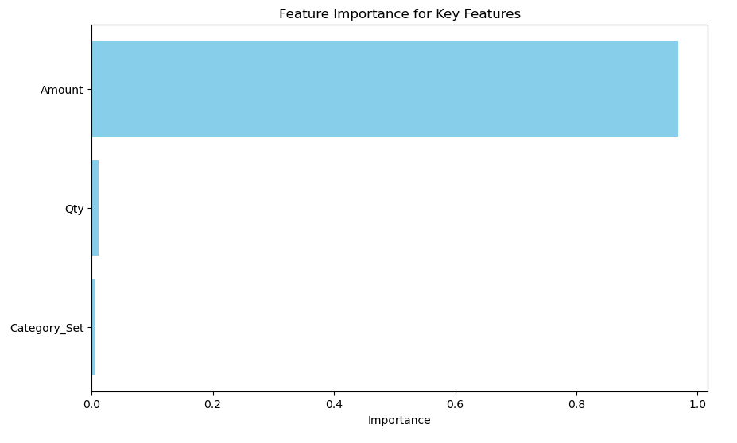
Feature Importance
Key Features:
Amount (0.968393)
Qty (0.011805)
Category_Set (0.004894)

Slide 9
Recommendations and Conclusion
Recommendations:
Cluster 0: Increase marketing efforts for low-demand products (e.g., Blouse, Bottom, Dupatta).
Cluster 1: Maintain current strategies for moderately performing products (Western Dress).
Cluster 2: Emphasize premium quality and exclusivity in marketing campaigns for high-priced items (Ethnic Dress).
Cluster 3: Ensure sufficient inventory levels, focus on maintaining competitive pricing, and continue strong promotional efforts for high-demand products (Kurta and Set).
Further Research:
Investigate customer demographics and purchase behaviors.
Explore time-series analysis for future sales trends.
Analyze the impact of promotions on product categories.

Slide 10
Conclusion
This project successfully analyzed Amazon sales data to identify key customer segments using clustering techniques. The models developed provided high accuracy in predicting clusters, with significant insights into the factors driving each cluster. The recommendations derived from the analysis offer actionable strategies to improve sales and marketing efforts. Future research can build upon these findings to further enhance business strategies and customer understanding.

